Slide 1
Shell Bootcamp 2024 3 Reflections for Week 2
Avni Tonger
Date : 29-Aug-2024

Slide 2

My learnings from this week!

Slide 3
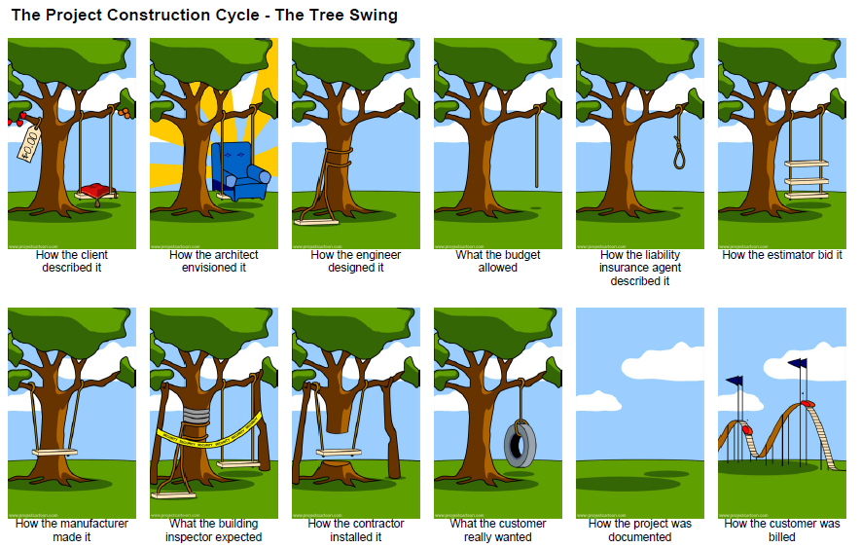
Learning 1 | Business Analysis
Business analysis involves identifying business needs and determining solutions to business problems. It includes understanding processes, systems, and organizational structures to improve efficiency and effectiveness.
The key learning is that thorough business analysis helps in making informed decisions, optimizing processes, and achieving strategic goals.
Effective business analysis leads to better decision-making and improved business performance.How do I personally see this concept implemented in the Energy sector
In the Energy sector, business analysis is crucial for optimizing operations, reducing costs, and ensuring sustainable practices.

Slide 4
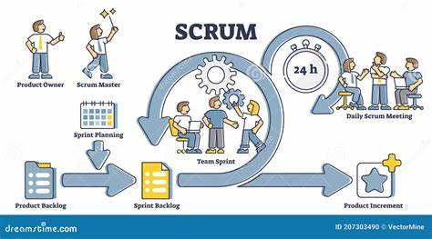
Learning 2 | SCRUM
Scrum is an agile framework used for managing and completing complex projects. It emphasizes iterative progress, collaboration, and flexibility.
Key Learning:The key learning is that Scrum promotes teamwork, adaptability, and continuous improvement through regular feedback and iterations.
Key Takeaway: Using Scrum can enhance project efficiency and team collaboration.
In the Energy sector, Scrum can be used to manage projects more effectively, ensuring timely delivery and adaptability to changing requirements.

Slide 5
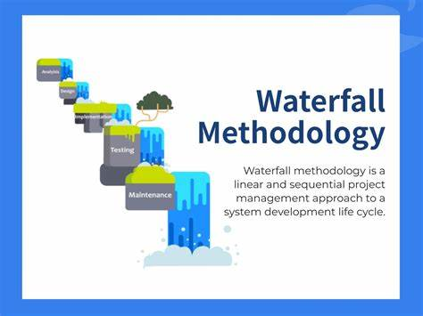
Learning 3 | Waterfall method
The Waterfall method is a linear project management approach where each phase must be completed before the next one begins. It involves distinct stages such as requirements, design, implementation, testing, and maintenance.
Key Learning:
The key learning is that the Waterfall method provides a structured and sequential approach, which is beneficial for projects with well-defined requirements and clear objectives.
Key Takeaway:
Using the Waterfall method ensures thorough documentation and a clear project timeline, which can help in managing expectations and deliverables.
How I Personally See This Concept Implemented in the Energy Sector:
In the Energy sector, the Waterfall method can be used for projects with fixed requests.

Slide 6
Thank You

